Slide 1

Bake House: Your Online Bakery Delight
Bake House offers a comprehensive e-commerce bakery experience. We combine tradition and modernity to meet customers' needs with ease and convenience.

Slide 2
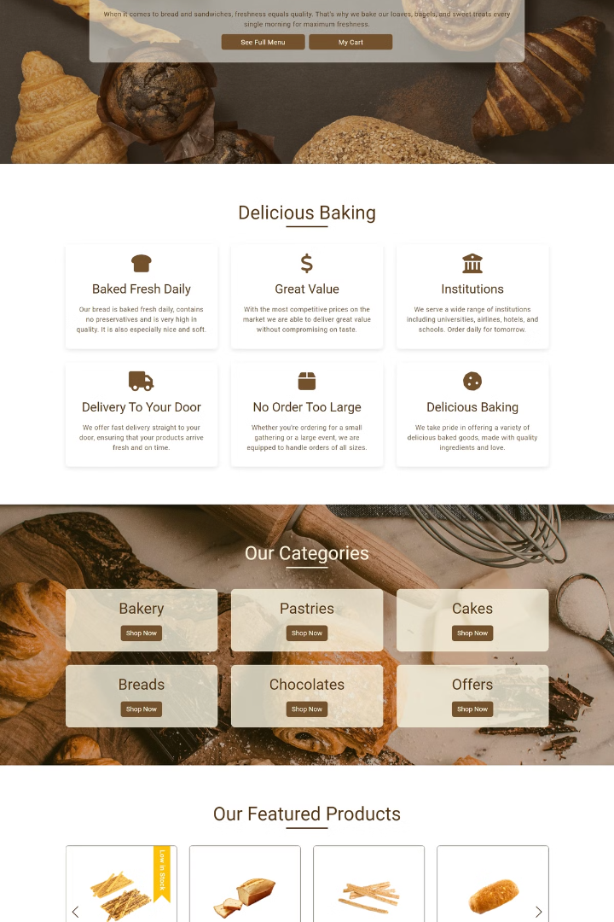
Website Objectives
1
Showcase Products
Display bakery's product range in a visually appealing way.
2
Provide Information
Offer comprehensive details about products, including prices and ingredients.
3
Improve Customer Outreach
Enable reservations and pre-orders to enhance customer convenience.
4
User-Friendly Interface
Deliver an easy-to-use interface catering to all age groups.

Slide 3
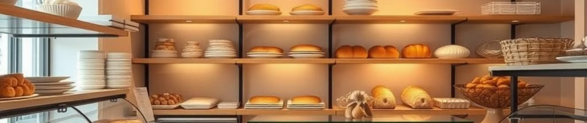




Technologies Used
HTML
SASS
TypeScript
Angular
Structures the basic layout and defines elements of the website.
Enhances styling management and speeds up development process.
Adds interactivity and improves user engagement on the site.
Creates a dynamic single-page application experience.

Slide 4
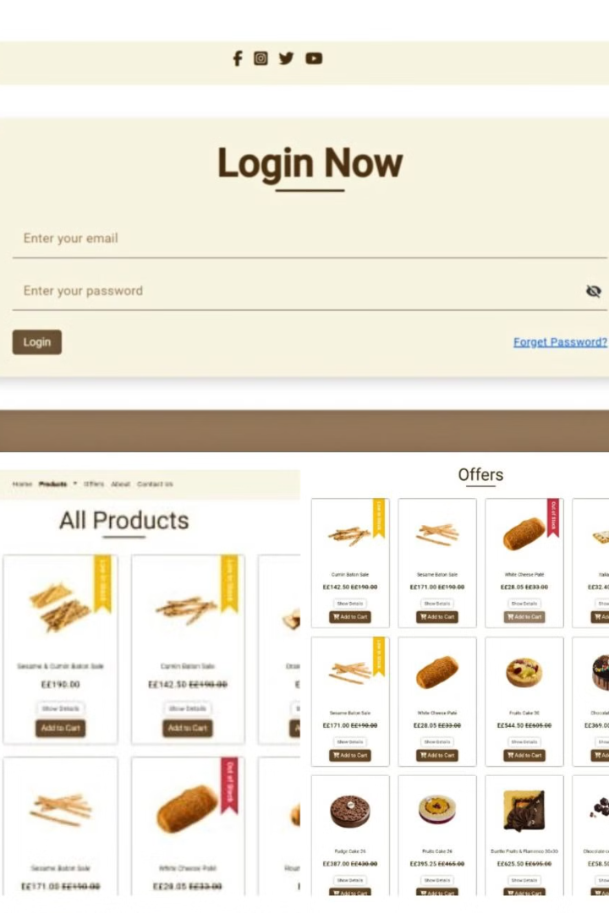
Key Pages
1
Login Page
Features a simple design with warm colors, aligning with the bakery's brand identity.
2
Home Page
Welcomes users with popular product images and navigation buttons.
3
Products Page
Lists bakery offerings with filtering and search options.
4
Offers Page
Showcases latest deals and discounts to attract customers.

Slide 5
User Experience Focus
Responsive Design
Interactive Elements
Visual Appeal
Ensures consistent display across various devices, enhancing user experience on desktops and mobiles.
Utilizes JavaScript for dynamic menus and smooth interactions.
Employs warm colors and inviting imagery to reflect the bakery's cozy atmosphere.

